Slide 1
2023 EOTC Management Templates 3 Key Changes
Gemma Periam
eotcsupport@eonz.org.nz

Slide 2
Karakia
Notes:
Here is a karakia for the day – listen to the link below for the pronunciation and also a conversation about what it means in more detail
https://www.youtube.com/watch?v=mKUUu6cREZM
This karakia came from the resource Tihē Mauri Ora –Maori Language Junior Classes to Form 2 – Syllabus for schools – first published in 1990. This was the first syllabus for the teaching of Māori, it was identified as a watershed moment in the development and recognition of Māori language and Māoritanga as a significant component in the education of NZ children. Pulled together many initiatives both local and national into a coherent document that formed the basis for teaching and learning of Māori language in the NZ school curriculum

Slide 3
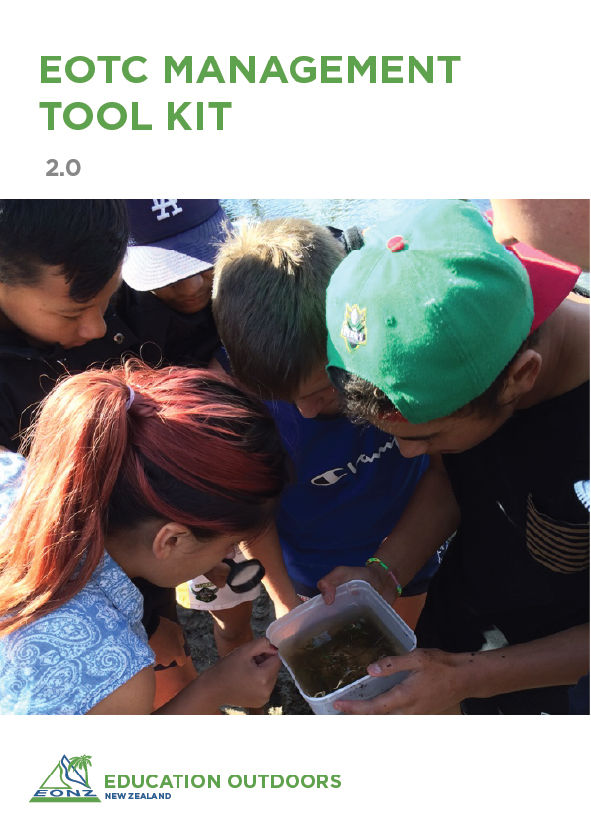
2023 update.
What has changed?
A Tool Kit guide
EOTC coordinator tools
A set of examples
(Better formatting)
Linked Here
Notes:
Participants have link in the course confirmation email
Better formatting - professional. Tables and diagrams do not lose formatting and can be changed more easily
Tool Kit Guide - explains what each form is for and how to use them
EOTC coordinator tools - set of tools to manage staff competencies & deployment, induction of staff and review
Examples - for a range of activities at a Y10 multi-day camp

Slide 4
Let’s take a quick look at what is in it
1 Safety Management Plan
2 EOTC Procedures
3 Tool kit templates
4 Examples - for a Y10 multi-day camp
5 EOTC coordinator templates
Notes:
Could jigsaw it
- each person at a table take one area and share main points with the rest of the group. Or
- each table has a different section. Back to whole group any feedback or questions.
Could scroll through altogether on the big screen
Could scroll through

Slide 5
Digging deeper – what else?
Operational limits and weather dependence
Inclusion and Diversity
Change in risk rating matrix
Determining activity and staff competencies

Slide 7
Operational limits
Refer EOTC forms:
3A, 3B, 3C Standard Operating Procedures – “Operational Limits” page 2) Activity proposal, approval & intentions – “Weather Planning” (page 2)
2 Risk Assessment & Supervision – “..environmental operational limits..” (p3)

Slide 8
Weather dependence
Refer EOTC forms:
1 Activity proposal, approval & intentions – “Weather Planning” (page 2)
2 Risk Assessment & Supervision – “Is this activity weather dependent?” (p3)
3 Standard Operating Procedures – Section B: “Site, Event and Group Specific Info” (p4)

Slide 9
Inclusion and Diversity
Refer EOTC forms:
11 Individual Ākonga Support Planning
1 Activity proposal, approval & intentions – “Supervision requirements” (page 2)
2 Risk Assessment & Supervision – “Ākonga with additional needs” (p2)
3 Standard Operating Procedures – Section B: “Participants needing extra support” (p4)

Slide 10
Risk Rating Matrix…
Likelihood of injury/harm | Severity of injury/harm
 | Insignificant | Minor | Moderate | Major |  | Catastrophic
 | No / Minor injuries | First Aid | Medical treatment | Extensive injuries |  | Fatalities
Almost Certain | Medium | Medium | High | Extreme |  | Extreme
Likely | Low | Medium | High | High |  | Extreme
Possible | Low | Medium | Medium | High |  | Extreme
Unlikely | Low | Low | Medium | Medium |  | High
Rare | Low | Low | Low | Medium |  | High
Refer: pp 22-24
Safety Management Plan Template – EOTC procedures

Slide 11
Activity Competence & Staff competence
Refer EOTC Coordinator forms:
Staff Competency Database
Activity Competency Requirements
Refer EOTC forms:
4 Staff Agreement Form
1 Activity proposal, approval & intentions – “Supervision requirements” (page 2)
2 Risk Assessment & Supervision – “Leadership & Supervision Plan” (p5)

Slide 12
Staffing and Supervision
Cornerstones of learning safely
Competent Staff
Clear roles and responsibilities
Effective supervision

Slide 13
Systems and practice go hand in hand
Reviews of School EOTC Management Systems & practice are too often showing a disconnect between good systems and good practice.
The paperwork won’t keep ākonga safe, what actions Kaiako take on the day does.
But, without thinking critically in the planning of an EOTC event, (and briefing other leaders and assistants on their role, responsibilities, and front of mind risks) – everyone can be unprepared to act critically.
Do you have a great up to date system that most of your staff struggle to complete correctly? Do they understand risk rating? Do they know that an effective supervision structure needs to be implemented not ‘ratios’ and do they know what one looks like? Do they know their role and what to do in an emergency?

Slide 14
Notes:
Te whakaeatanga e
Te whakaeatanga e
Tēnei te kaupapa ka ea
Tēnei te wangana ka ea
Te mauri o te kaupapa ka whakamoea
Te mauri o te wāngana ka whakamoea
Koa ki runga, koa ki raro
Haumi e, hui e, taiki e
It is completed, it is done,
we have achieved our purpose, completed our forum,
let the purpose of our gathering rest for now,
let the vitality of our discussions replenish,
we depart with fulfilled hearts & minds,
bonded in our common goal & unity

